Slide 1
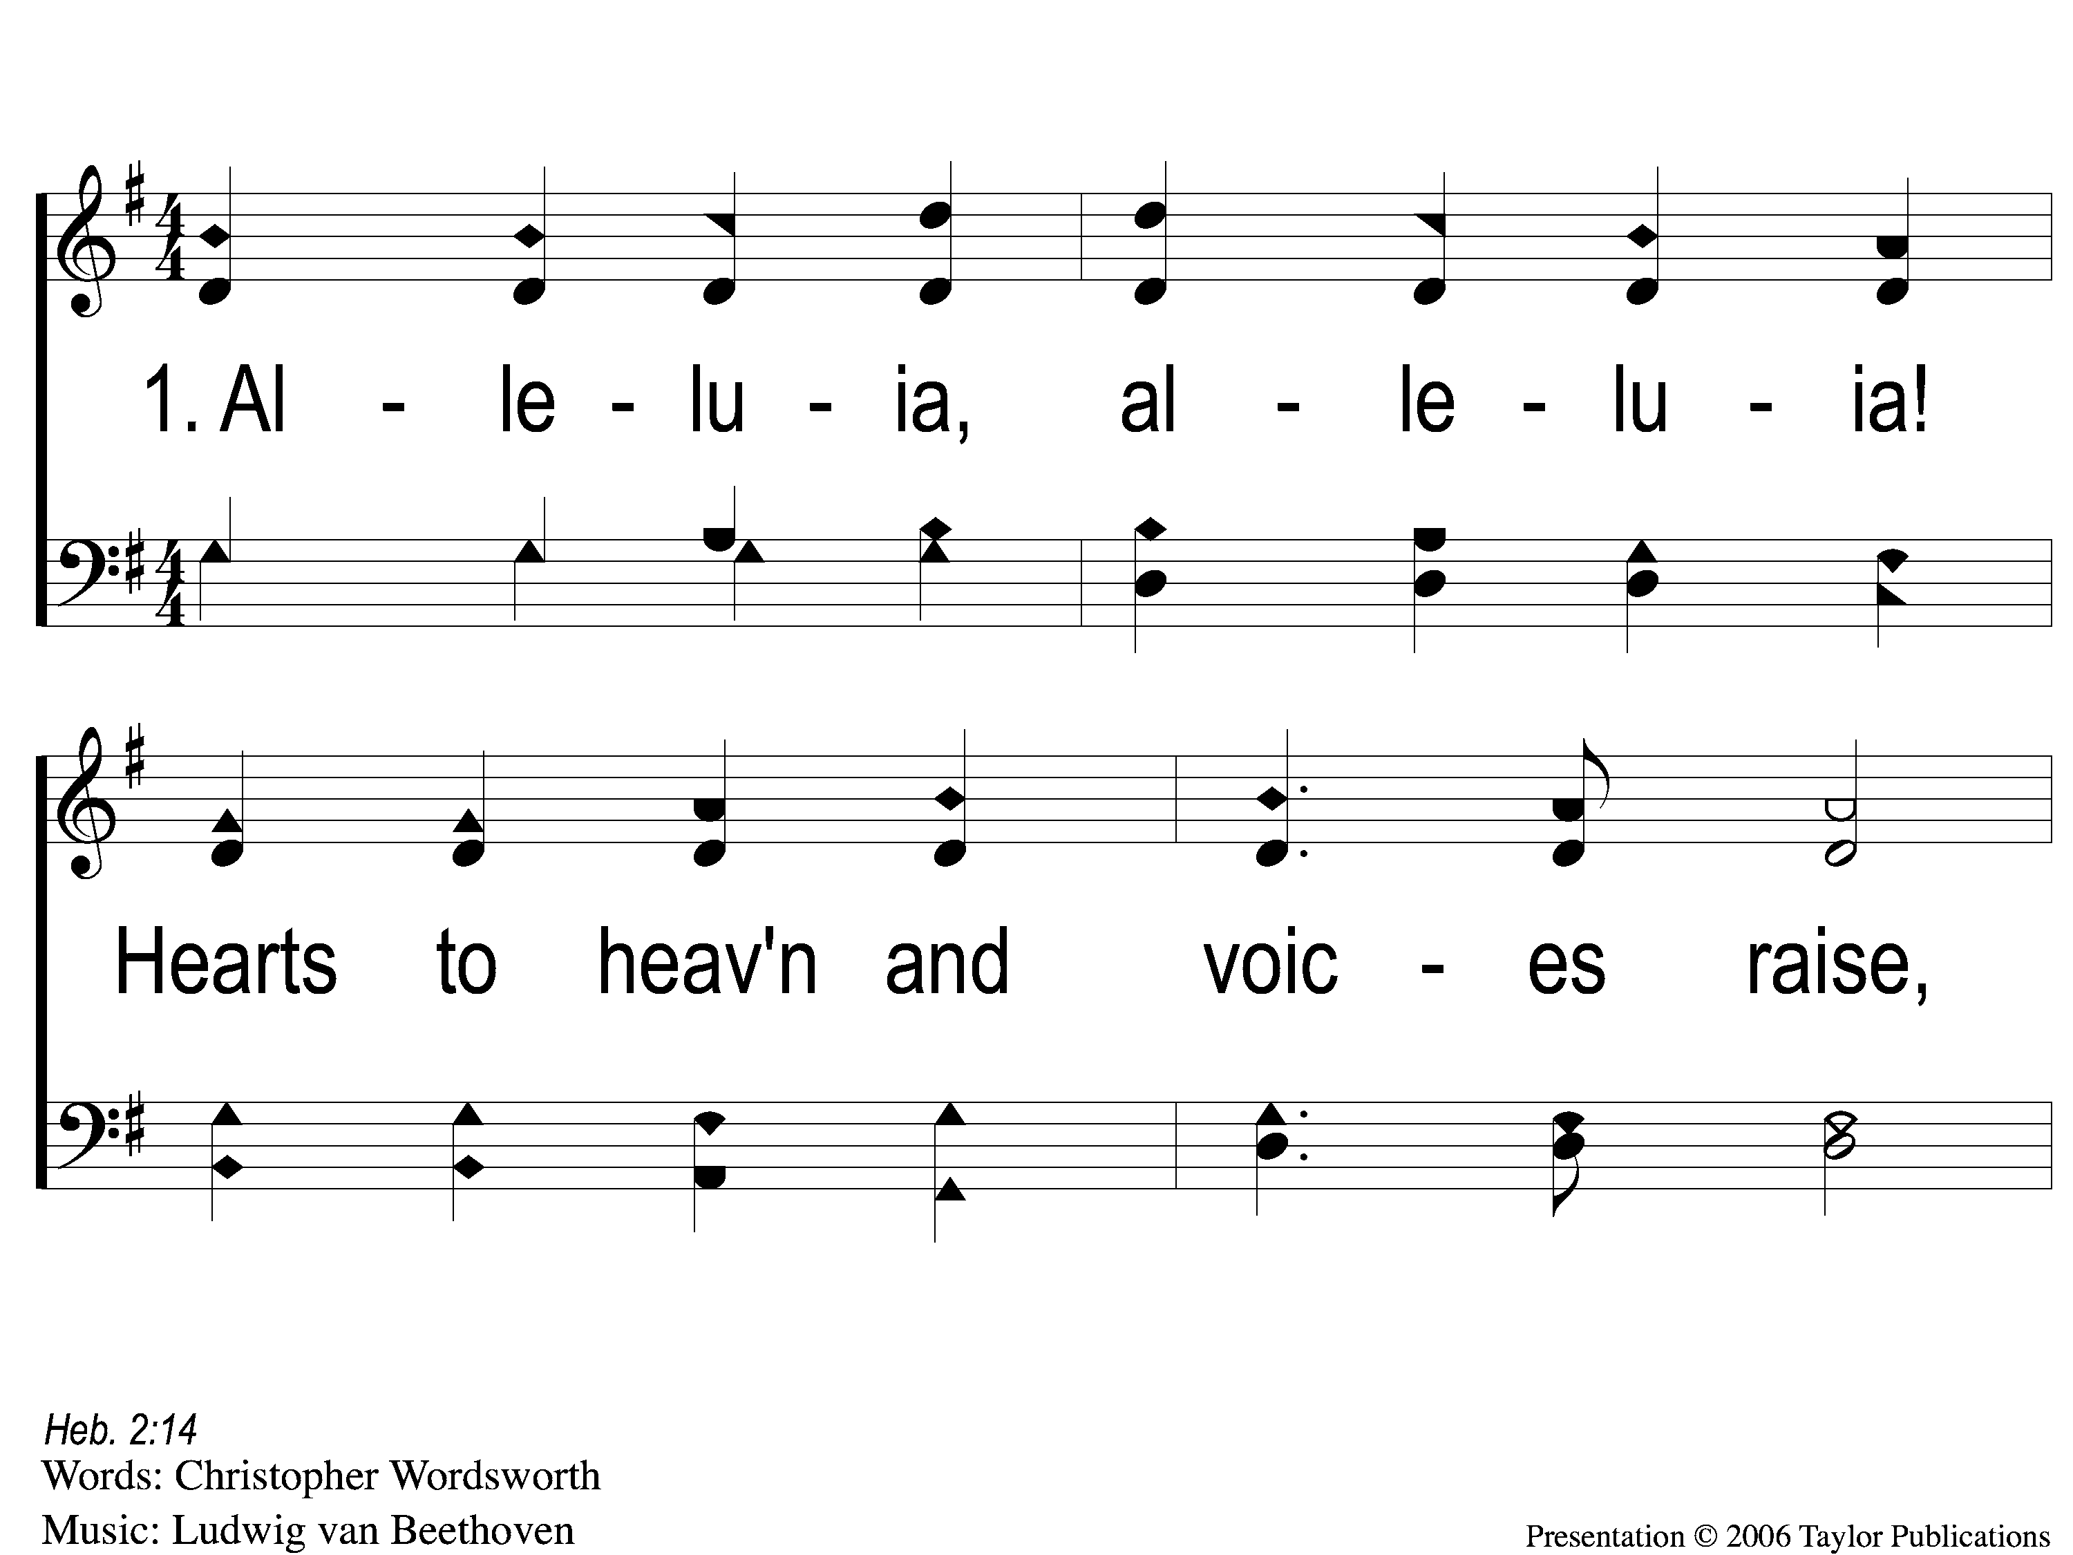
1-1 Alleluia! Hearts to Heaven
Alleluia, Alleluia! Hearts to Heaven
146

Slide 2
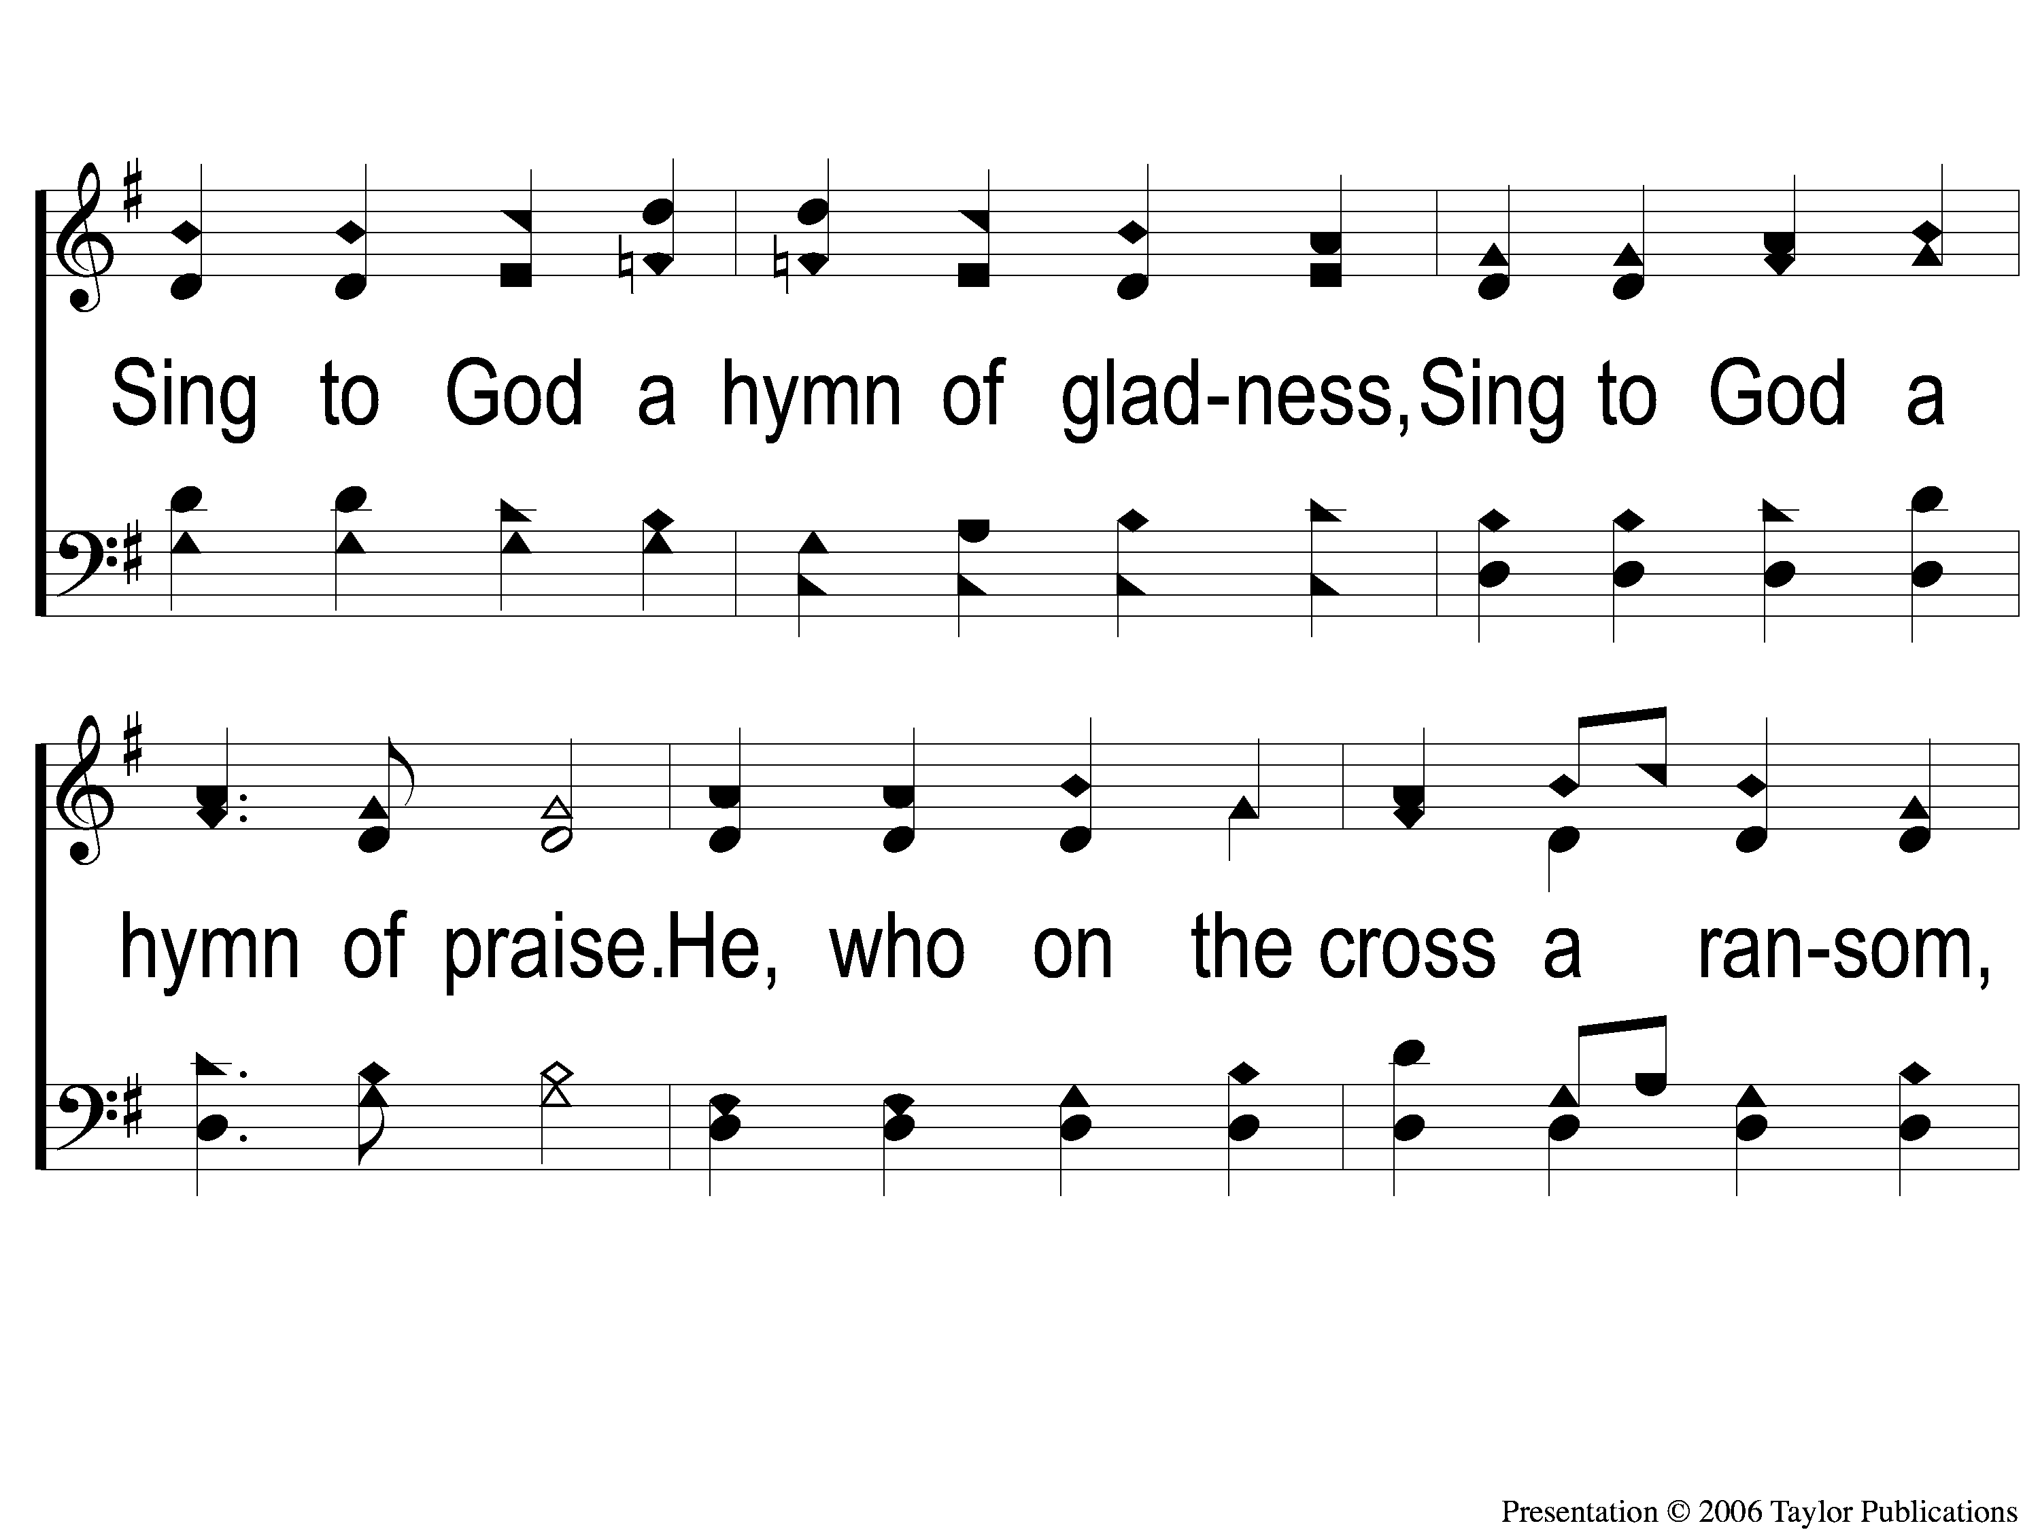
1-2 Alleluia! Hearts to Heaven
Alleluia, Alleluia! Hearts to Heaven
146

Slide 3
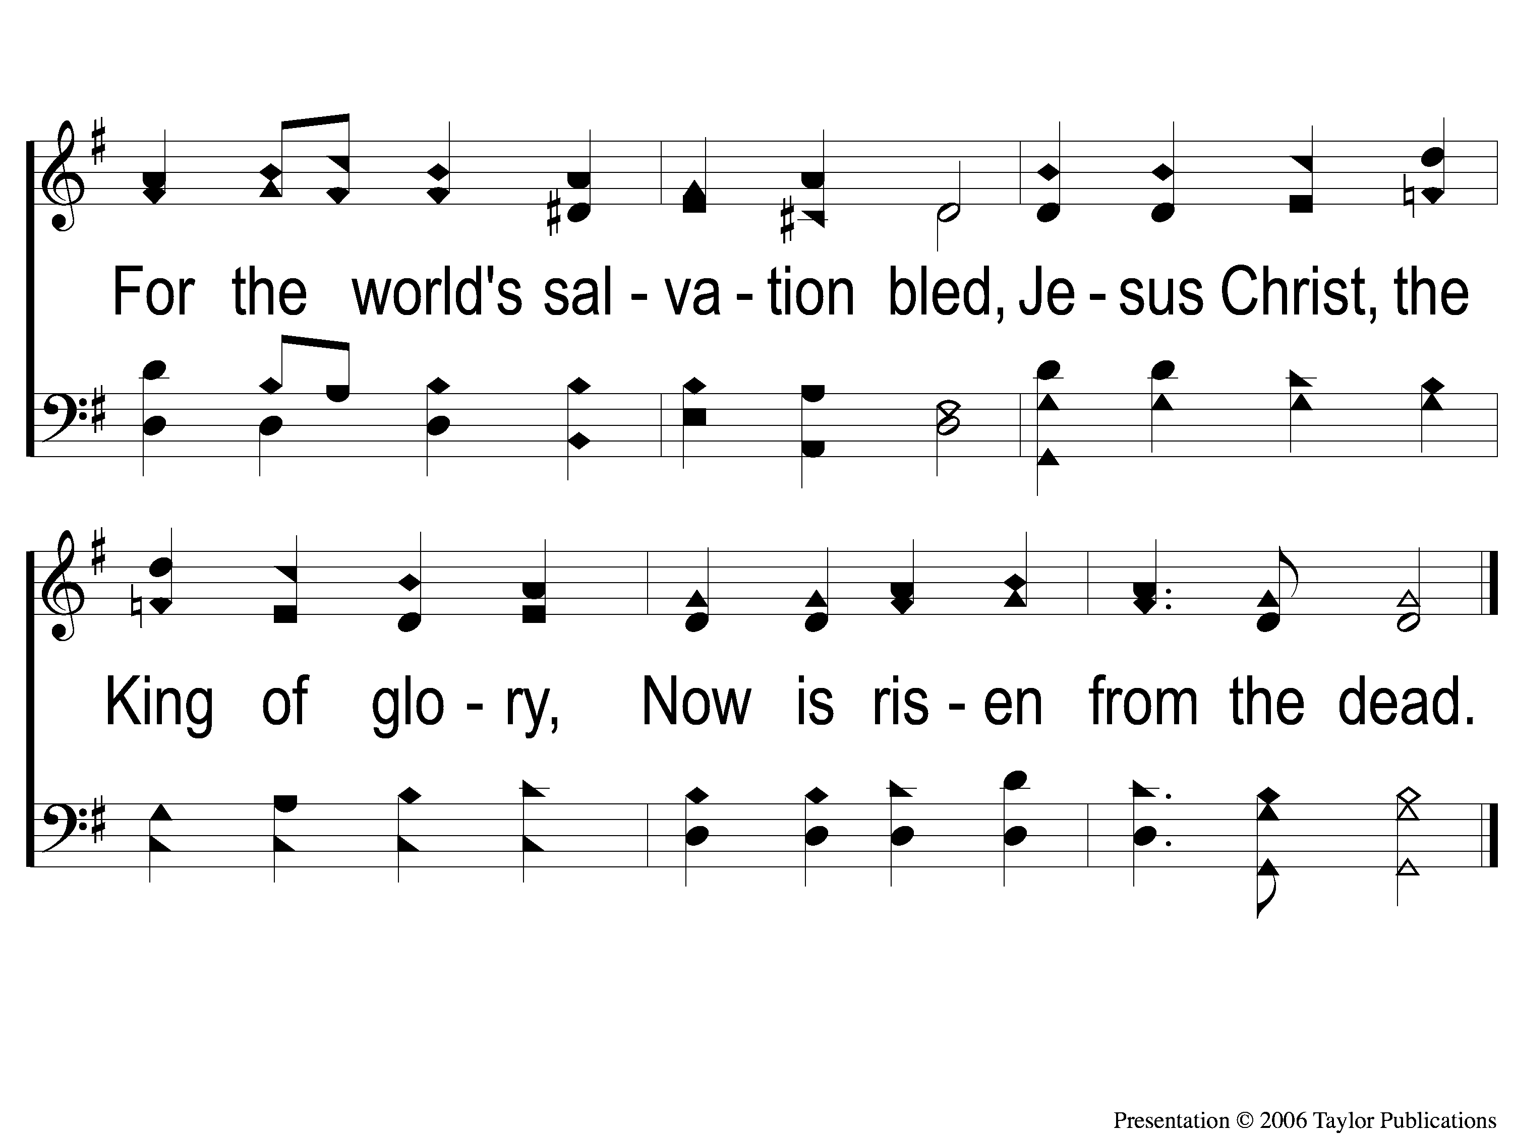
1-3 Alleluia! Hearts to Heaven
Alleluia, Alleluia! Hearts to Heaven
146

Slide 4
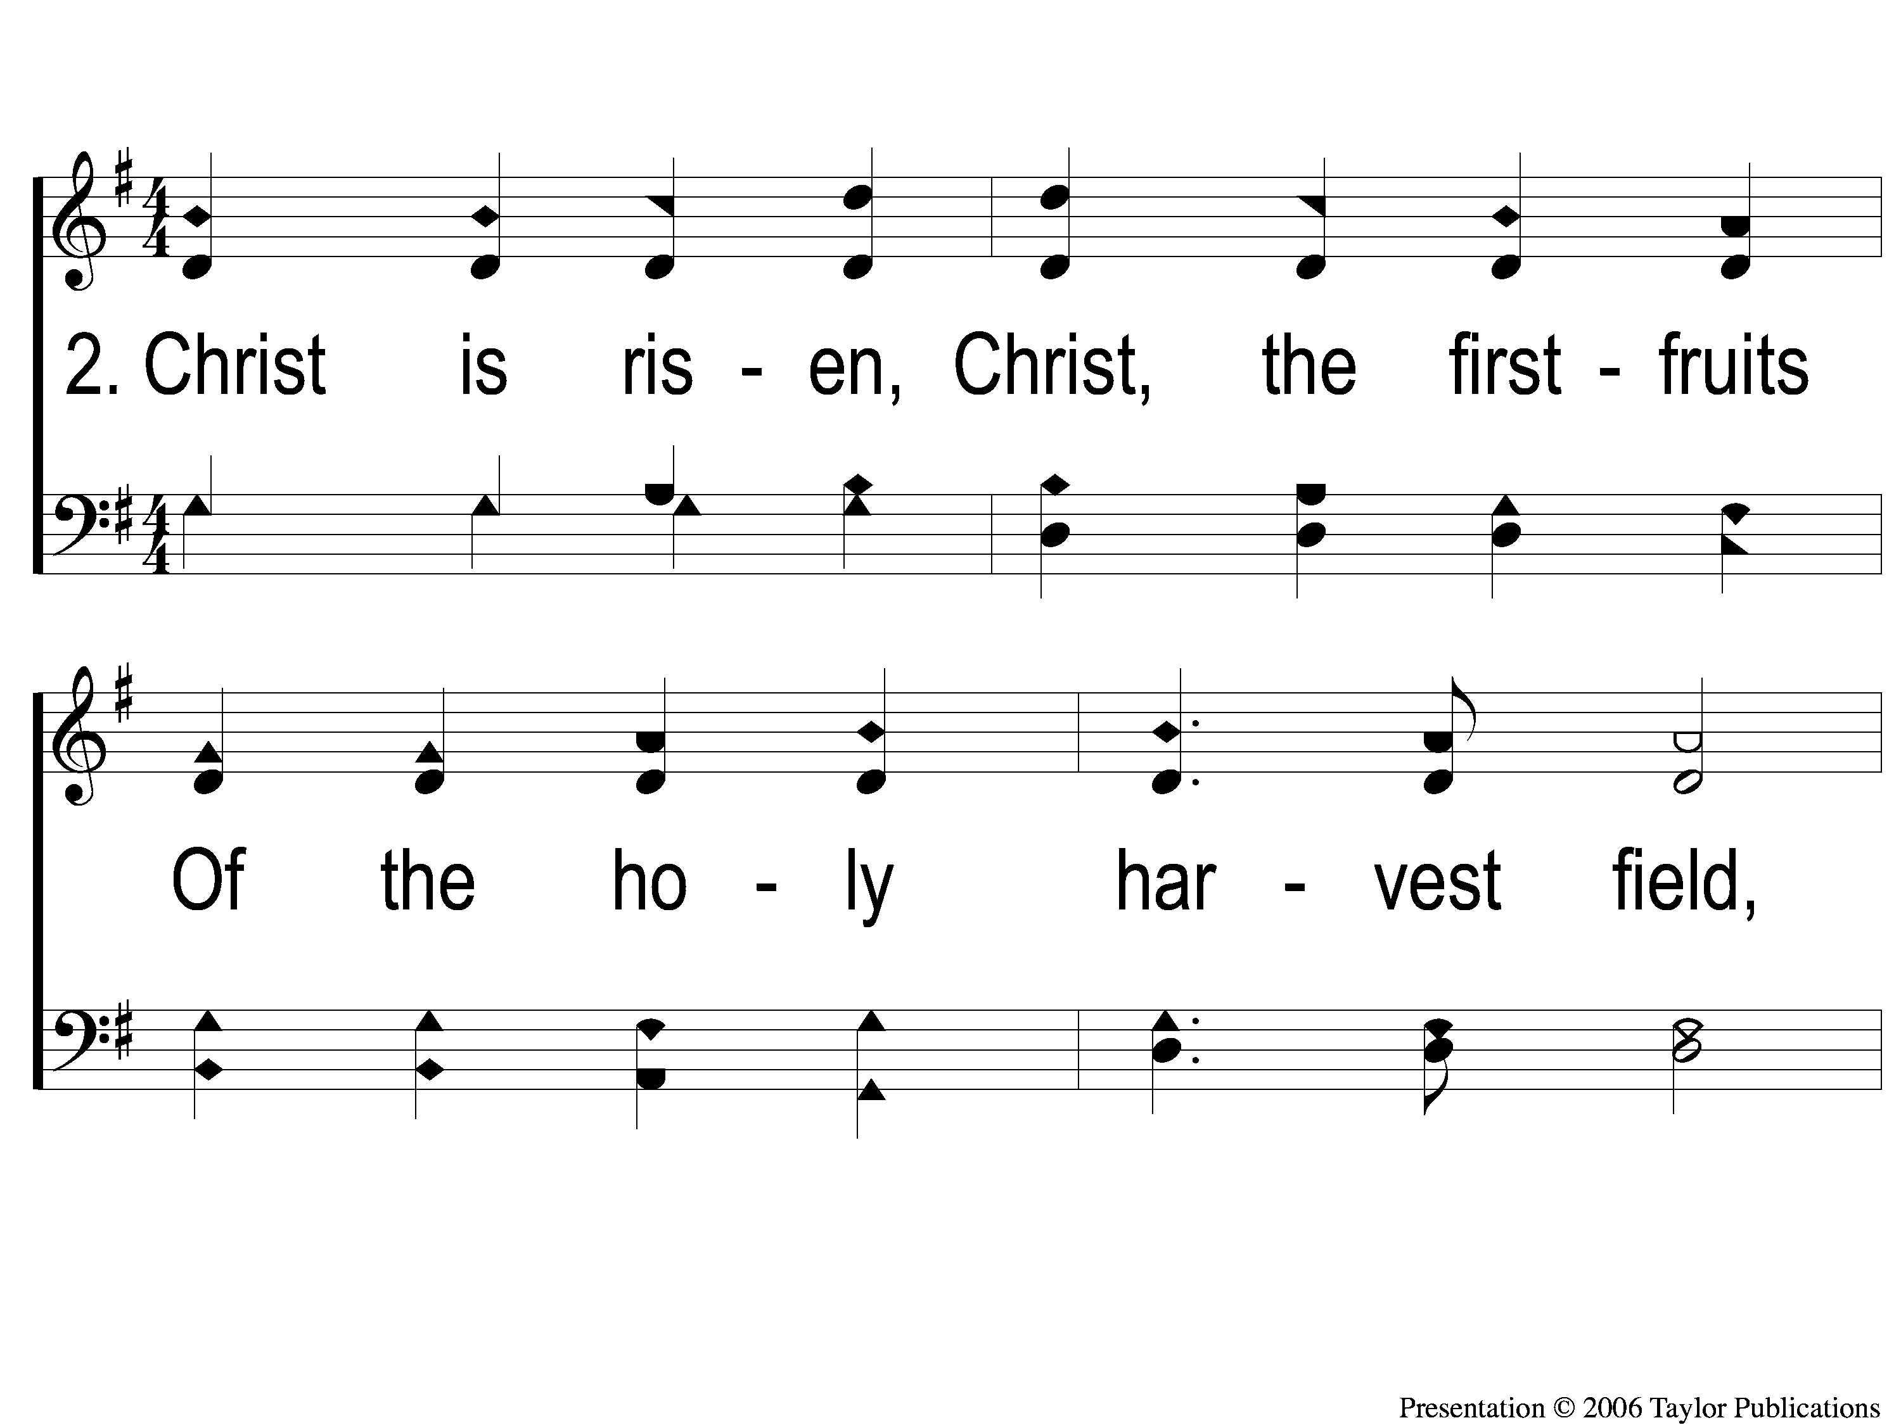
2-1 Alleluia! Hearts to Heaven
Alleluia, Alleluia! Hearts to Heaven
146

Slide 5
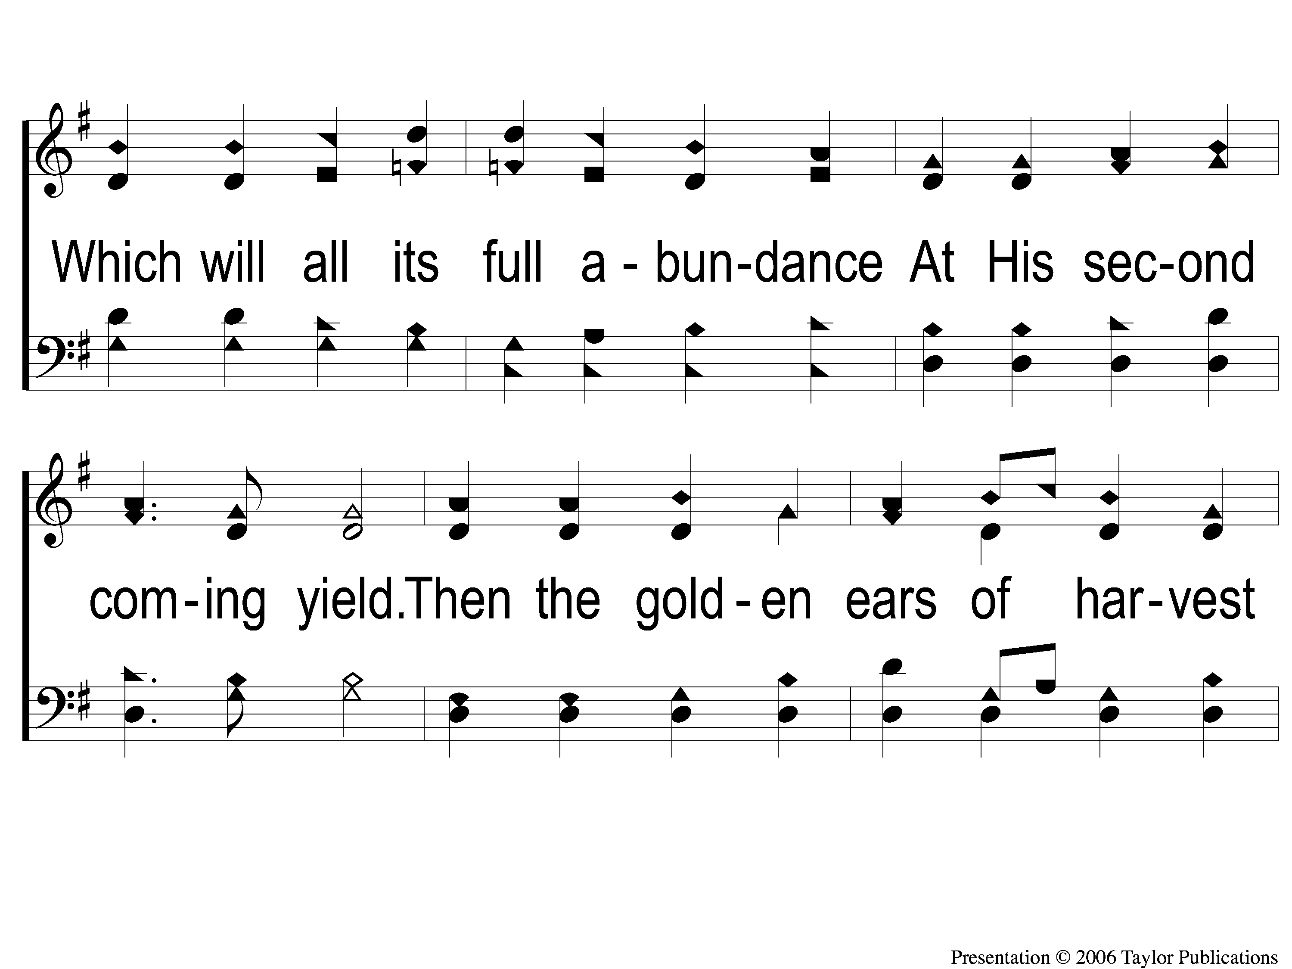
2-2 Alleluia! Hearts to Heaven
Alleluia, Alleluia! Hearts to Heaven
146

Slide 6
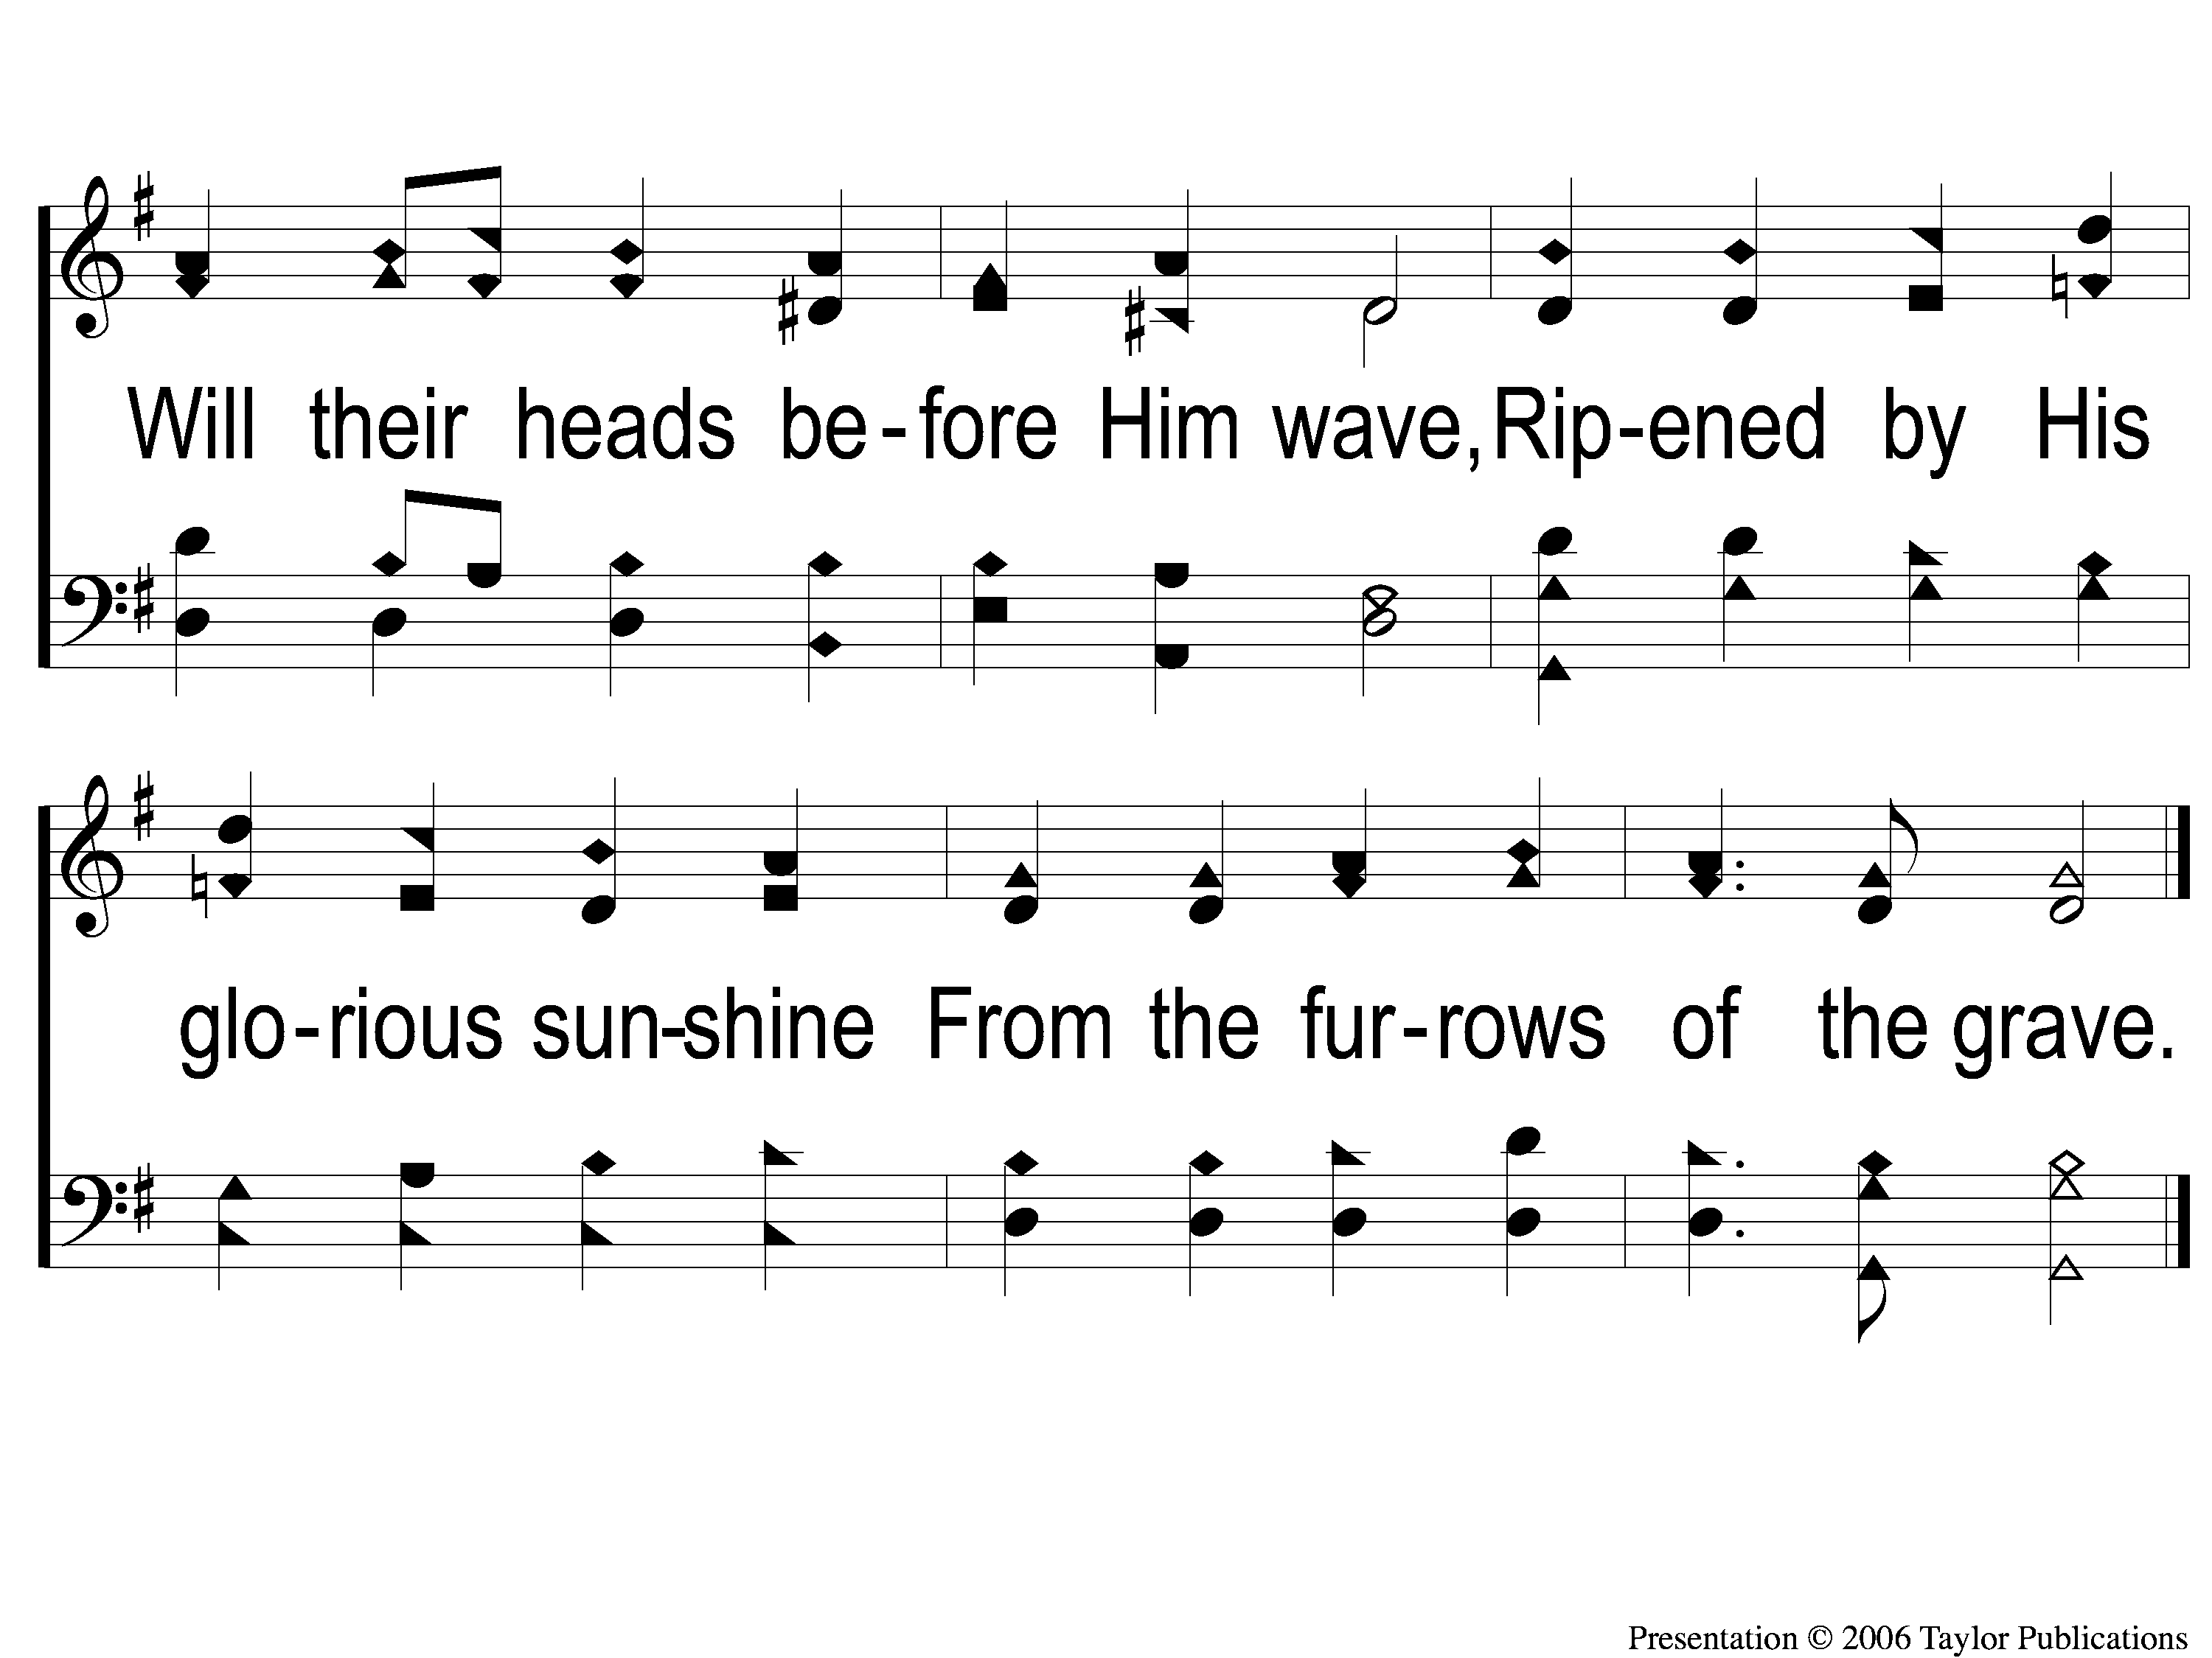
2-3 Alleluia! Hearts to Heaven
Alleluia, Alleluia! Hearts to Heaven
146

Slide 7
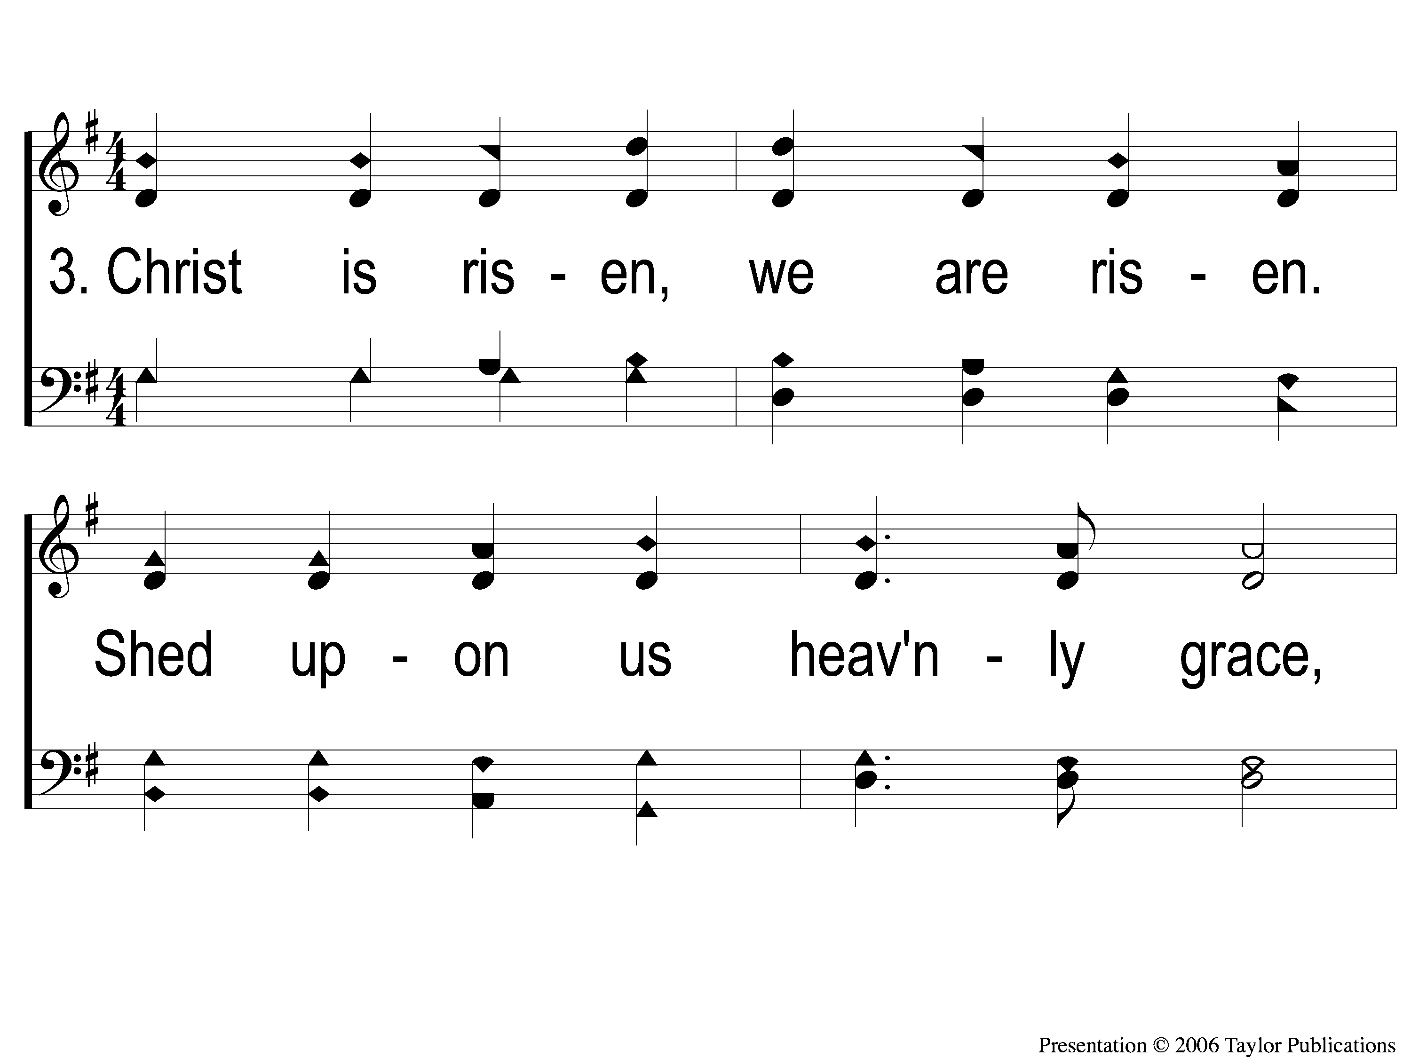
3-1 Alleluia! Hearts to Heaven
Alleluia, Alleluia! Hearts to Heaven
146

Slide 8
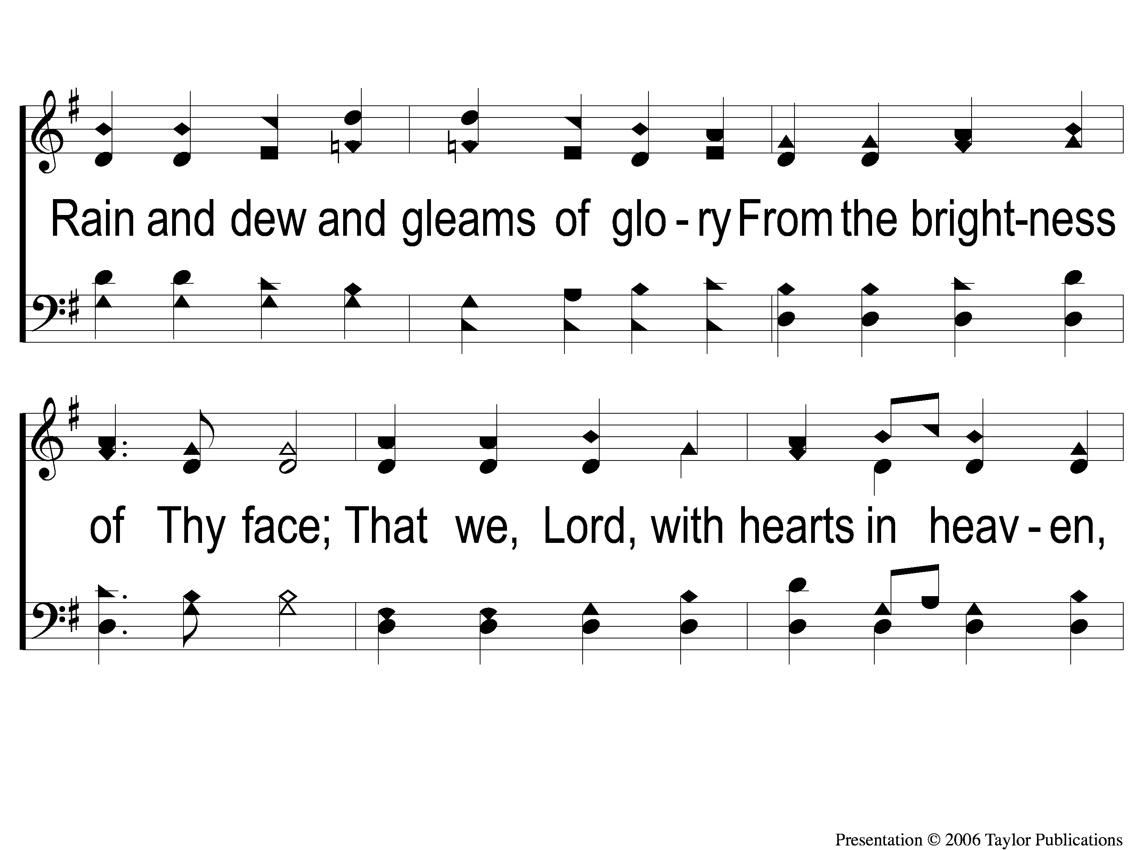
3-2 Alleluia! Hearts to Heaven
Alleluia, Alleluia! Hearts to Heaven
146

Slide 9
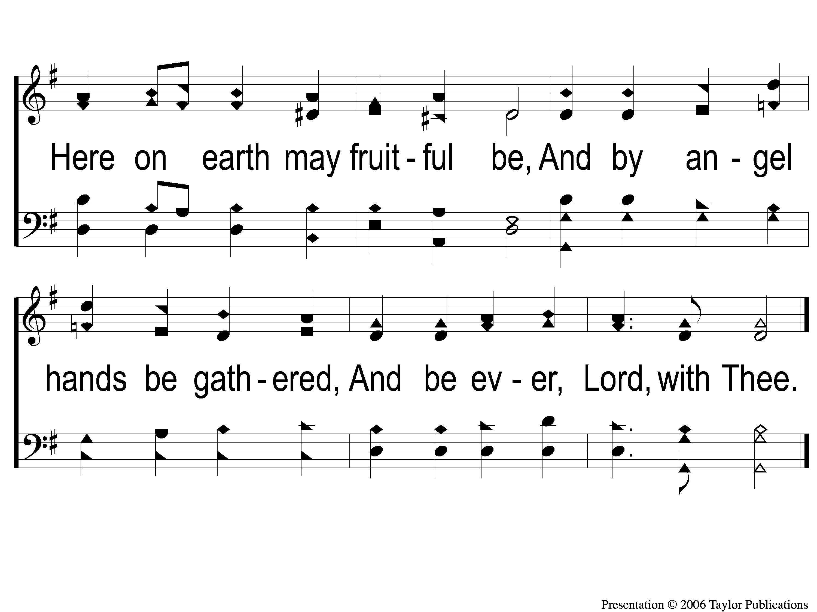
3-3 Alleluia! Hearts to Heaven
Alleluia, Alleluia! Hearts to Heaven
146

